Slide 1
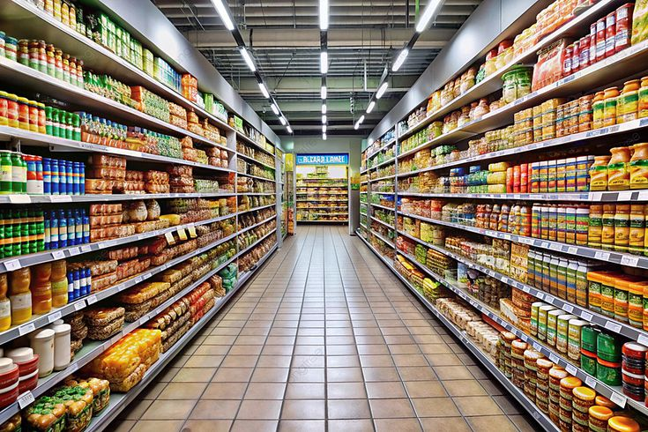
Superstore Marketing Campaign Analysis Predicting Gold Membership Acceptance
Submitted by: Sonu Kumar
Career 247 — Data Analytics with GenAI
February 2026

Slide 2
What Problem Are We Solving ?
Superstore runs yearly Gold Membership campaign
Offers 20% discount on all purchases
Only 14.91% customers say YES — Why so low ?
Our Goal:
→ Find WHO will accept
→ Find WHAT drives spending
→ Improve next campaign

Slide 3
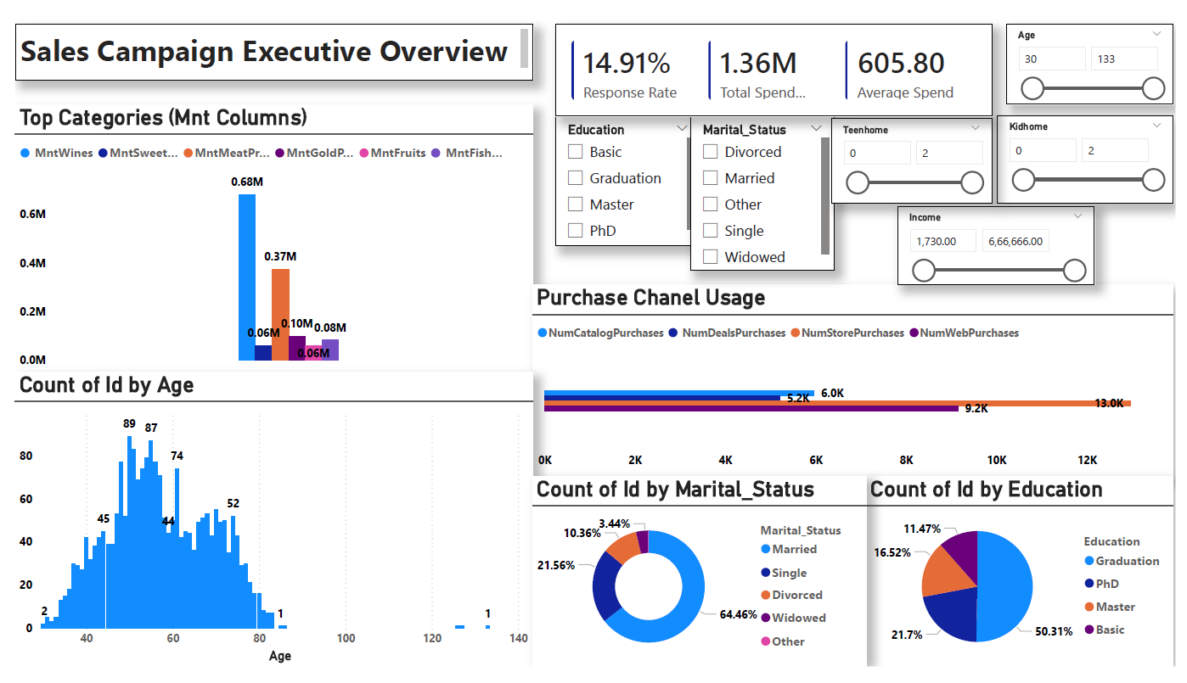
Campaign Performance at a Glance
14.91%
Response Rate
$1.36M
Total Revenue
$605.80
Average Spend
2,240
Total Customers
Live Power BI Executive Dashboard — Interactive filters available

Slide 4
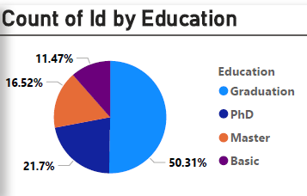
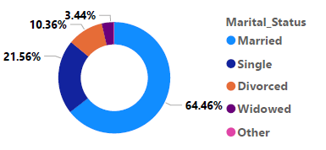
Customer Demographics — 2,240 Customers
Education Distribution
Marital Status
50% Graduates | 22% PhD holders
64% Married | 22% Single
Majority Age Group: 40-70 years

Slide 5
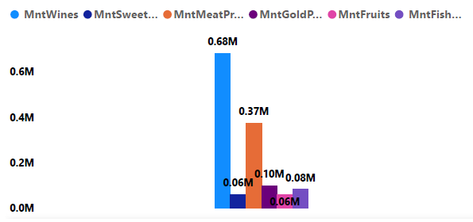
Spending Pattern — Wine & Meat Dominate
Wine $680,000 (50%)
Meat $370,000 (27%)
Combined 77% of ALL revenue
Insight: Target Wine & Meat lovers first!

Slide 6
Three Types of Customers
LOW SPENDER
Below $500
1,245 customers
55.6%
MEDIUM SPENDER
$500 — $1,500
749 customers
33.4%
HIGH SPENDER
Above $1,500
246 customers
11%
⭐ Priority Target These 246 drive maximum ROI

Slide 7
Biggest Insight: Children Change Everything
2.7x Difference
p-value < 0.001
WITH CHILDREN
Avg Spend: $406
Acceptance: 10.3%
WITHOUT CHILDREN
Avg Spend: $1,106
Acceptance: 26.5%
Current membership does NOT appeal to families

Slide 8
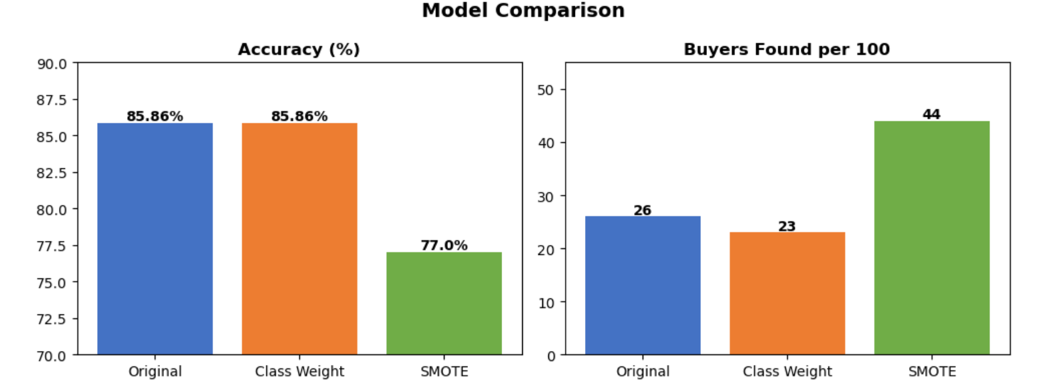
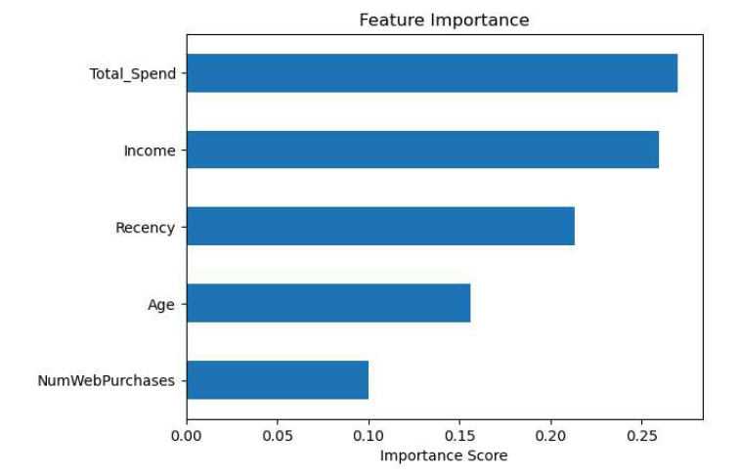
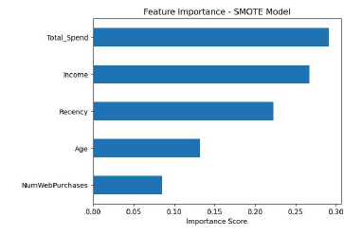
Machine Learning Model — Predicting Acceptance
85.86%
Model Accuracy Random Forest
Top Predictors:
Total Spend
Income Recency

Slide 9
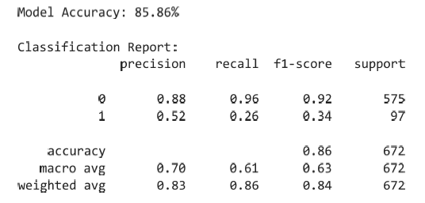
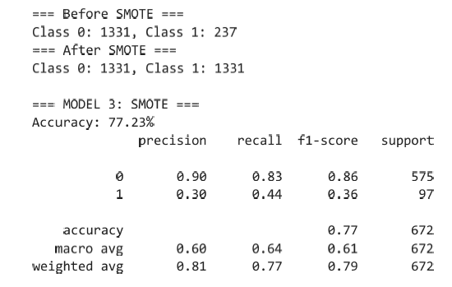
Model Improvement: Solving Class Imbalance
Base Random Forest (Accuracy): 85.86%
Optimized with SMOTE (Recall): 44%
Technique Used: Applied SMOTE (Synthetic Minority Over-sampling Technique) to generate synthetic
samples for the minority class (Buyers).
Strategic Shift: Prioritized Recall over Accuracy to ensure fewer potential leads are missed during the campaign.
Business Impact: Identifying 44% of buyers (vs 26%) allows for a more effective and high-ROI marketing outreach.

Slide 10
6 Actions to Boost Membership Uptake
1. Email PhD & Masters
856 customers 20.78% acceptance rate
4. Win-back inactive
Recency > 60 days Special catalog offer
2. Family Gold Bundle
Food category discounts Target 10.3% gap
5. Digital Conversion
10% first online order 1,563 in-store shoppers
3. Wine & Meat Bundle
"Gourmet Food Club" 77% revenue focus
6. VIP for High Spenders
Personal outreach 246 customers — top ROI

Slide 11
Thank You
Model optimized for Recall (44%) to maximize customer reach
PhD customers = Best target segment
High Spenders = Most Likely to Accept
6 Data-driven recommendations delivered
Excel | MySQL | Python | Power BI
Sonu Kumar
Career 247 — Capstone Project
February 2026

